Slide 1
Nonsense Mediated Regulation(NMD)of Arsenic Detoxification Genes in Saccromyces cervisase Under Different Growth Conditions
Presented by Stephnie Nwaiwu
Notes:
So, i want to check if the expression of genes involved in arsenic detoxification changes in the different growth conditions. As far as I know, there is no RNA-Seq data examining the effects of NMD after cells are exposed to arsenic

Slide 2
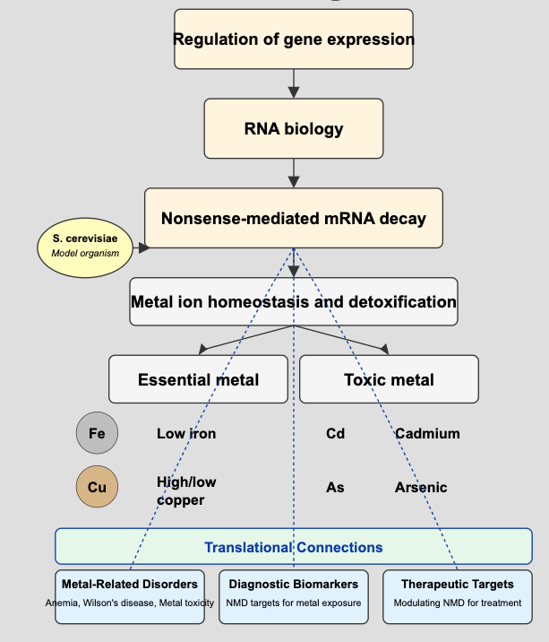
Notes:
"Our lab studies the nonsense-mediated mRNA decay pathway, or NMD,
Using yeast as our model, we've discovered NMD plays a crucial role in metal ion homeostasis. We investigate how this pathway helps cells respond to essential metals like iron and copper, and detoxify harmful metals like cadmium and arsenic.
The significance of our work extends to human health in: understanding metal-related disorders like anemia; identifying biomarkers for metal exposure; and developing novel therapies by modulating NMD.

Slide 3
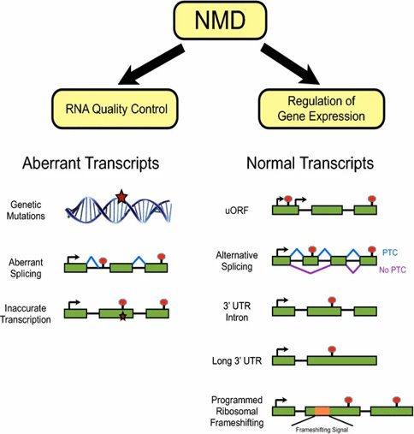
Understanding the Nonsense Mediated pathway
What is the Nonsense mediated pathway?
The nonsense-mediated mRNA decay (NMD) pathway is a specialized mRNA degradation pathway that degrades select mRNAs.
Notes:
NMD prevents the accumulation of faulty or truncated mRNAs that could produce toxic, non-functional proteins. So pathway eliminates defective mRNAs but also regulates natural mRNAs.
By turning NMD on/off, the cell can selectively stabilize or degrade certain transcripts to adapt quickly to stress. NMD intersects with pathways like the unfolded protein response (UPR), p53, and even immune signaling.
This positions NMD as a regulatory checkpoint that fine-tunes key pathways in real-time
This allows cells to dynamically adjust gene expression, especially during development, differentiation, and environmental changes.
This protects the cell from proteotoxic stress and supports protein homeostasis.

Slide 4
Does the regulation of mRNAs involved in arsenic detoxification by NMD vary across different growth conditions in Saccharomyces cerevisiae?

Slide 5
Objective
To develop an R script that analyzes RNA-Seq data to determine whether NMD-mediated regulation of arsenic detoxification genes (ARR1, ARR2 and ARR3) varies under different growth conditions (normal, low iron, and low/high copper stress).
Generate clear visual representations of expression trends to support conclusions.

Slide 6
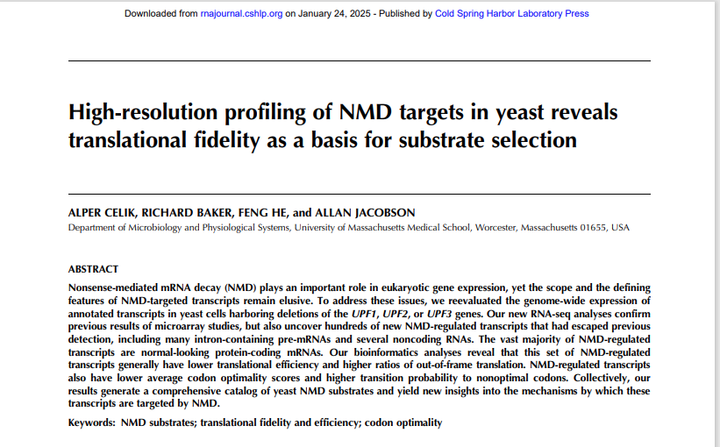
First RNA data Source

Slide 7
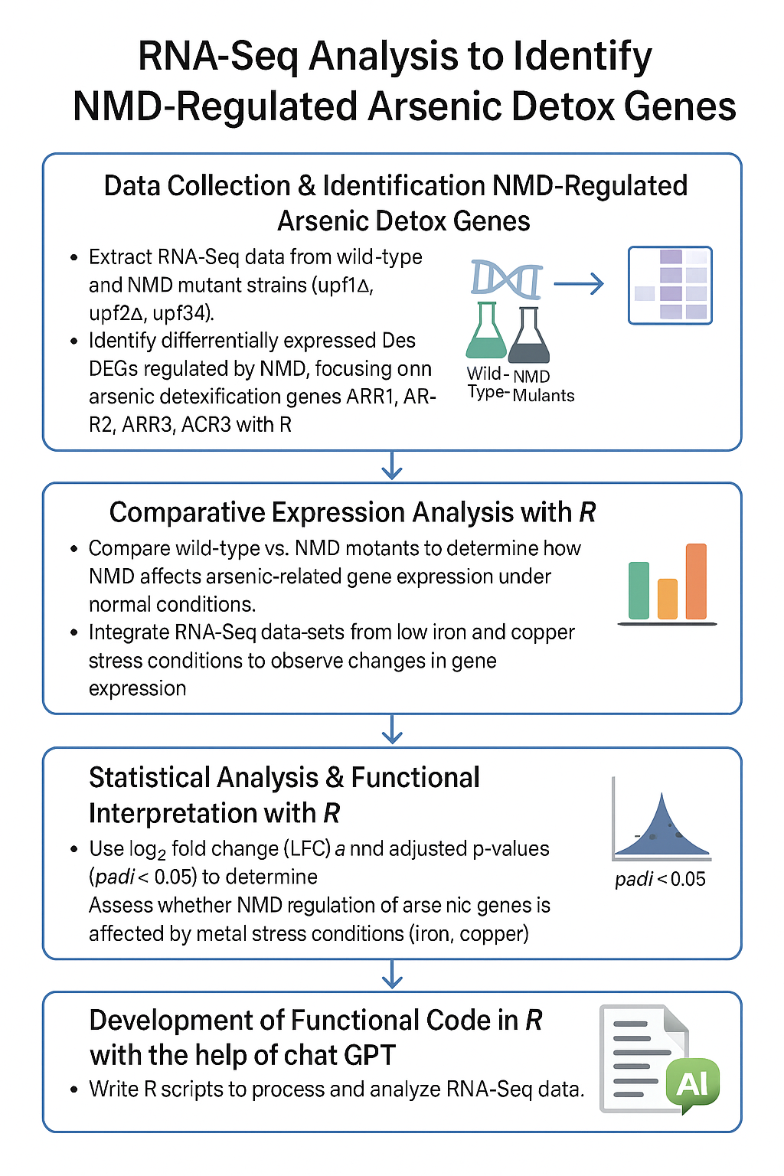
Approach

Slide 8
# Load required libraries
library(ggplot2)
library(dplyr)
library(tidyr)
# Create a data frame with the log2 fold change values
# Format: Gene, Mutant, log2FoldChange
data <- data.frame( Gene = rep(c("ARR1", "ARR2", "ARR3"), each = 3),
Mutant = rep(c("UPF1", "UPF2", "UPF3"), 3),
log2FoldChange = c(
# ARR1 values for UPF1, UPF2, UPF3
0.76, 0.74, 0.72,
# ARR2 values for UPF1, UPF2, UPF3
0.05, 0.11, 0.32,
# ARR3 values for UPF1, UPF2, UPF3
0.77, 0.78, 0.92
)
)
# Set custom colors for each mutant
mutant_colors <- c("UPF1" = "#FF6B6B", # Red
"UPF2" = "#6BCB77", # Green
"UPF3" = "#4D96FF") # Blue
# Create the bar plot plot
<- ggplot(data, aes(x = Gene, y = log2FoldChange, fill = Mutant)) +
geom_bar(stat = "identity", position = position_dodge(width = 0.8), width = 0.7) +
# Add a horizontal line at y = 0 geom_hline(yintercept = 0, linetype = "dashed", color = "black", size = 0.3) +
Notes:
Finding the file on R, loading libraries

Slide 9
# Customize the plot appearance scale_fill_manual(values = mutant_colors) +
# Set axis labels and title
labs(
title = "Log2 Fold Change of ARR Genes in NMD Mutants",
x = "Gene",
y = "log2(Fold Change)"
) +
# Customize the theme
theme_light() +
theme(
panel.grid.major = element_line(color = "#EEEEEE"),
panel.border = element_blank(),
axis.line = element_line(color = "black"),
legend.position = "right",
legend.title = element_text(face = "bold"),
plot.title = element_text(hjust = 0.5, face = "bold"),
axis.title = element_text(face = "bold")
) +
# Set y-axis limits
scale_y_continuous(limits = c(0, 1), breaks = seq(0, 1, by = 0.25))
# Display the plot
print(plot)
# Save the plot as a high-resolution image
ggsave("ARR_genes_log2fc.png", plot, width = 8, height = 6, dpi = 300)
ggsave("ARR_genes_log2fc.pdf", plot, width = 8, height = 6) # Vector format for publication

Slide 10
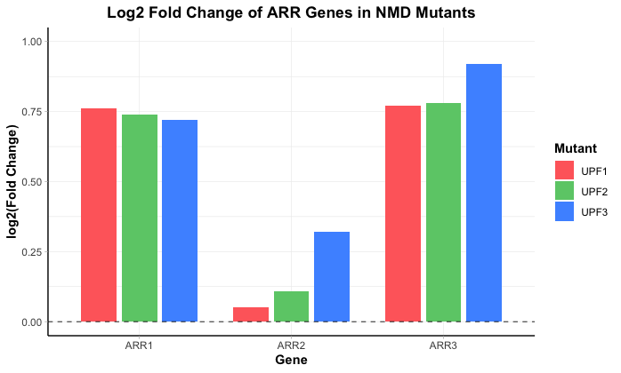
Differential Expression Analysis in Normal Conditions
Notes:
ARR1 and ARR3 transcripts are upregulated in NMD-deficient yeast strains (upf1Δ, upf2Δ, upf3Δ), suggesting that both are targets of the NMD pathway. In contrast, ARR2 shows minimal changes in expression, indicating it is likely not regulated by NMD. These findings highlight selective NMD-mediated control over genes involved in arsenic detoxification.
So I will definitely get a different result, when I do the same for low iron and high copper.

Slide 11
Conclusion
By completing this project, I will gain insight into how the NMD (nonsense-mediated mRNA decay) pathway influences the expression of arsenic detoxification genes in Saccharomyces cerevisiae under different metal stress conditions.
By comparing expression patterns across wild-type and NMD mutants under different stresses, you'll be able to prioritize genes like ARR1, ARR2 or ARR3, or based on how they respond.
Notes:
This will help me understand whether NMD plays a dynamic, condition-specific role in regulating stress-responsive genes, and whether its impact shifts in response to changes in environmental factors like iron and copper availability.
….which will make my downstream analyses more targeted and meaningful.

Slide 12

Thank you!

